Slide 1

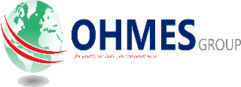
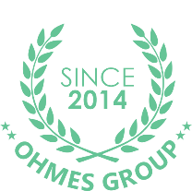
OHMES GROUP
ORGANOGRAM STRUCTURE & MANAGEMENT
MAY 2024

Slide 2
Vision, Mission, Core Values
Strategy
  Levels Of Strategy
Organogram
  Types Of Organogram
Why We Need An Organogram
Ohmes Organogram
Result Of Our Org Structure
AGENDA

Slide 3
OHMES GLOBAL
Mission
Vision
VISION
To be a leading ICT, Medical –ICT and other Specialized Services’ Provider in West Africa, and in other parts of the World.
MISSION
We shall create value for all customers and stakeholders through innovative ideas, quality services and satisfactory deliveries.
Goal
Strategy
STRATEGY
Business Growth, Operational Excellence and Innovation
GOAL
“...for quality service, you can count on us.’

Slide 4
Vision is a vivid, guiding image of the organization's desired future.
Mission statement is a formal, written document that defines the organization’s purpose in society.
Core value is referring as the attitude and character of an organization, and often dictates employee behavior. Also, core value is at the heart of the culture of an organization.
In other words, knowing why you’re doing what you’re doing (your mission), where you’re trying to go (your vision), and how you’re going to go about it (your values) are the glue that holds an organization together. It is an essential part to building a company’s strategic foundation and developing a strategy

Slide 5
This utopian dream is generally described by one or more phrases or statements, which are brief proclamations that convey the organization's dreams for the future. By developing a vision and a mission statement, your organization makes the beliefs and governing principles of your organization clear to the greater community (as well as to your own staff, participants, and volunteers).

Slide 6
H
Hundred percent quality & Genuine Products
M
Meeting all set goals, and customers request...
if possible.
E
Equitable and Fairness to all
S
Service –Oriented.
O
Overachievement in all set targets
CORE VALUES:
Defines us – way of life
Gives us the sense of purpose
Connects us
Brands Us
Communication line
Notes:
This is our way of life

Slide 7



MISSION
/
VISION
VALUES
STRATEGY
CULTURE
GOALS
VALUES
GUIDING PATH
DRIVING PATH
OBJECTIVES
PRACTICES
ACTIVITIES
BEHAVIOURS
RESULTS

Slide 8
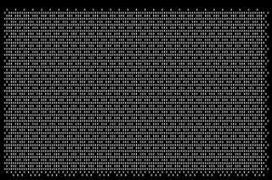
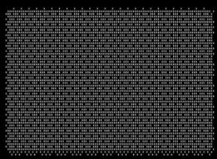



THE INTERDEPENDENT COMPONENTS THAT MAKE UP A STRATEGICALLY
ALIGNED ENTERPRISE
THE VALUE CHAIN IS ONLY AS STRONG AS ITS WEAKEST LINK
ENTERPRISE
PURPOSE
BUSINESS
STRATEGY
ORGANIZATIONAL
RESOURCES
MANAGEMENT
CAPABILITY
ARCHITECHURE
SYSTEMS
HOW WELL DOES OUR
HOW WELL DOES OUR
HOW WELL DO OUR
HOW WELL DO OUR
BUSINESS STRATEGY FULFILL OUR
ORGANIZATIONAL CAPABILITY
RESOURCES ENABLE
MANAGEMENT SYSTEMS
DRIVE
SUPPORT DELIVERY OF OUR
DEVELOPMENT OF OUR
THE PERFORMANCE OF OUR
BUSINESS STRATEGY?
REQUIRED
ORGANISATIONAL
VALUABLE
RESOURCES
?
ENTERPRISE PURPOSE
CAPABILITY
?

Slide 9
The only way we can create an amazing future for OHMES & ITS SHAREHOLDERS is if we do our work in a way that reflects universally shared values. This ensures we do not squander our time and resources rationalizing our actions. It helps to ensure we are not potentially squandering our community's goodwill.

Slide 10
HARD ELEMENTS: Strategy, Structure, and Systems
SOFT ELEMENTS: Shared Values, Skills, Style, Staff

Slide 11
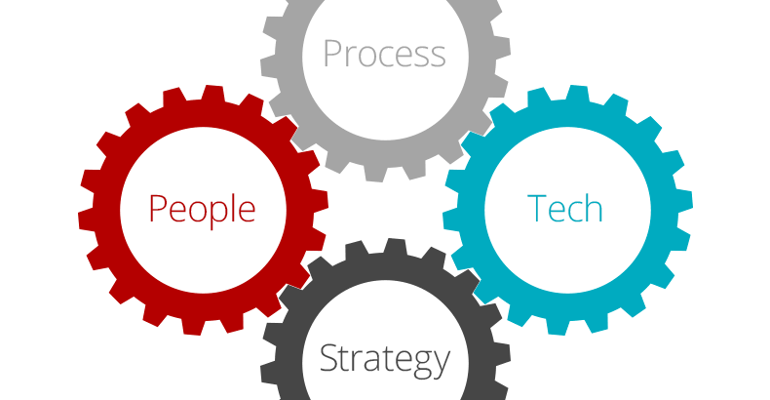
STRATEGY

Slide 12
HIERARCHICAL LEVEL OF STRATEGY
Strategy is not just asking for top executives. Middle and lower level managers too must be involved in the strategic planning process to the extent possible.
The Corporate/organization Strategy
comprises a directional strategy through a corporate vision and a mission statement.
The Business Strategy ensures that individual business units are able to increase their effectiveness while remaining jived with the corporate strategy.
The Functional Strategy has to be customized to ensure the business strategy to succeed. These could be HR, Marketing and/or Finance strategy.

Slide 13
SWOT Analysis and PESTLE Analysis Each global market provides unique opportunities and threats for doing business. The PESTLE framework includes political, economic, social, technological, legal, and environmental issues that impact a company, industry, or target location.

Slide 14
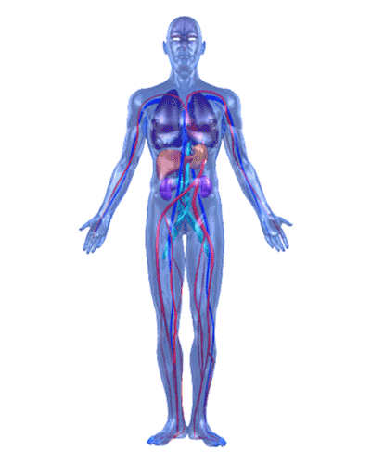
ORGANOGAM from the word organ; speaks to the different arms and bodies of an organization and their connectivity
An organogram is a graphical representation of an organization's structure. It shows hierarchical relationships between managers and the people who report to them, as well as departments.
An organogram is a useful tool for organizations to both visualize reporting relationships and communicate employees’ names, skills, and contact information. The term "organogram" is used most often in the UK and is synonymous with "org chart."

Slide 15
TYPES OF ORGANOGRAM
The evolution of the org chart is a fun one and there are functional organizations still alive and well, along with product, divisional, geographical, customer, matrix, flat, flatter

Slide 16
WHY DO WE NEED AN ORGANOGRAM?
BUDGET AND RESOURCE PLANNING
INCREASE INTERNAL COMMUNICATION An organization chart can help with internal communication, connecting employee in the company no matter where they are located or what they do for the organization.
MANAGING REORGS Corporate re-orgs happen at every level of organizational maturity. Re-orgs happen and when they do, you need to use org charts that can keep up and be up to date in real-time.
TEAM BUILDING What helps people forge friendships is finding similarities. Organizational charts can be ideal for team building when they enable employees to add more than just their job title and responsibilities. Names and titles are great,

Slide 17
WORKFORCE PLANNING - Design your organization's dream team with the roles you’d like to hire for. In your ideal organogram, list employee costs as a way to visualize and plan for the future.
EMPLOYEE ONBOARDING - Introduce new employees to your organization by sending them a link to your organogram. They’ll be able to see where they fit into the company, and the names, skills, and contact info of their coworkers.
SUCCESSION PLANNING - Succession planning can help your company prepare for things like promotions or a leader moving on, helping the HR team be ready for any shift in their workforce.

Slide 18
STAFF DIRECTORY - Organogram can double as a staff directory where employee contact information is easily accessible. Modern organograms should contain a list of employee names and roles. “Who’s responsible for that?”
CROSS-FUNCTIONAL TEAMS - Organograms can be built to show the structure of a cross-functional team. Employees can reference the organogram to understand who leads a team and who’s responsible for what. Having a single source of truth for a team can only improve communication.
INTERNAL HIRING TOOL - organizations can highlight open roles right on the organogram. It is a great way to increase employee retention and engagement.

Slide 19
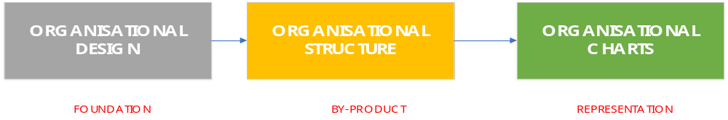
How a company is designed will naturally influence its corporate structure. The sole purpose of organizational design is to better reflect the more culturally diverse, collaborative environment of people who share ideas and information.
When organizational design drives the organizational structure, then the organizational charts can be a more accurate and useful rendering of company values, its culture and its focus

Slide 20
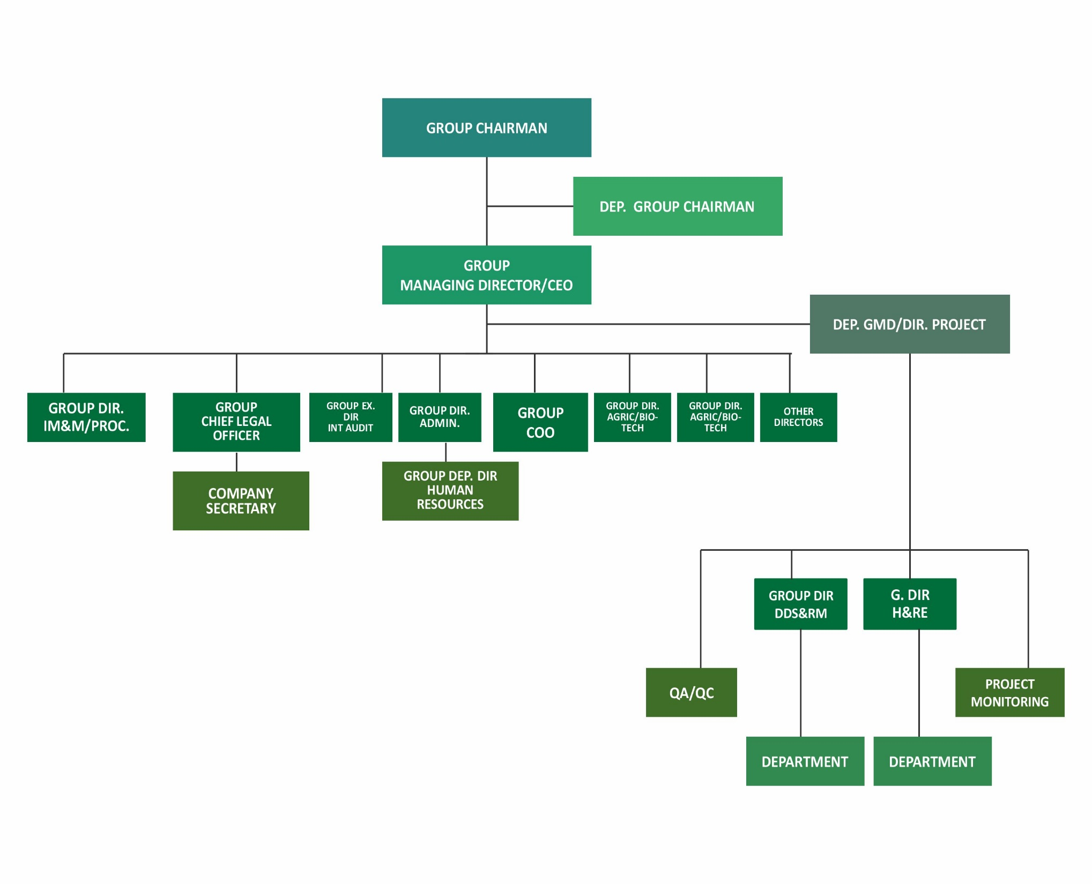

Slide 21

THINK GLOBAL ACT LOCAL
GLOBAL INTEGRATION BUT LOCAL RESPONSIVENESS
Global integration (GI) emphasizes consistency of approach, standardization of processes, and common corporate culture across global operations.
Local responsiveness (LR) emphasizes adapting to the needs of local markets and allows subsidiaries to develop unique products, structures, and systems.

Slide 22
RESULTS OF THE OHMES ORG STRUCTURE
Leveraging core competencies
• Core competence: Skills within the firm that competitors cannot easily match or imitate
• Earn greater returns by transferring these skills and/or unique product offerings
Licensing:
Firm in the host country is granted the rights to produce or sell a product. A low-risk entry strategy; avoids tariffs and quotas imposed on exports.
Leveraging subsidiary skills
Value created by identifying firm skills and applying them to its global network of operations
Strategic alliances:
A number of companies loosely or tightly joined for a variety of purposes
Multidomestic strategy
• Main aim is maximum local responsiveness
•Customize product offering, market strategy including establishing production and
• R&D
Equity partnership:
Acquiring partial ownership through purchase of shares.
Joint venture:
A form of strategic alliance with two or more companies producing a product or service together.

Slide 23
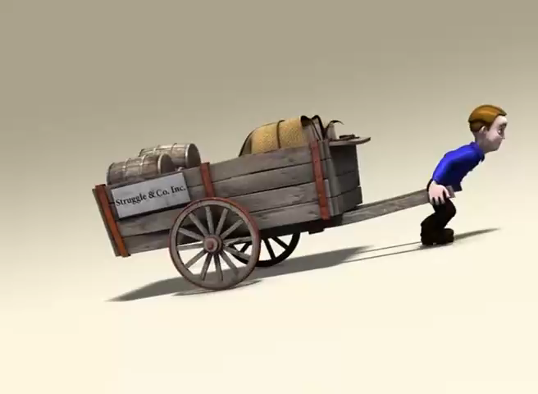

Slide 24
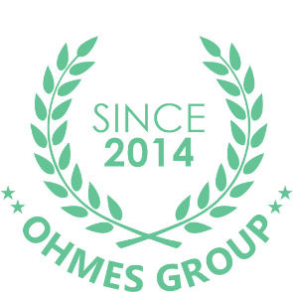
THANK YOU

